Slide 1
Instructions for making presentation (Remove this slide after reading this slide)
Please read before proceeding.
Use the font size and style as given in each Slide.
Maximum number of slides allowed is 17 (including References)
Use 1 slides for Introduction.
Use 2 slides for Literature Survey.
Use 1 slide discuss the Gaps/Issues addressed in the paper.
Use 1-2 slides of References.
Use 1 slide for conclusion of the paper
Use remaining slides for methodology/solution of problem, results in the paper.
You can give any heading to other slides as per your convenience

Slide 2
Instruction for making presentation (Remove this slide after reading this slide)
Please read before proceeding.
Use bulleted points/Phrase in the presentation. Please don't put sentence or entire paragraphs of theory on the slide.
Use more graphics/images and animation wherever necessary but DO NOT use animation for showing different bulleted items (i.e. bulleted item by item) on slides.
An example of animation slide is given after “References” Slide. You may use similar kind of animation.
Flow of presentation should be proper (i.e. every slide should be able to relate with the previous slide and next slide.)
Do not change the order of the slides.
Remove animation slide given at the end if you are not using any animation.
Best of luck.

Slide 3

Third Year B.Tech
DSP Lab – Exp - 8
DSP Application
Department of Computer Engineering
Sardar Patel Institute of Technology
(Autonomous Institute affiliated to Mumbai University) Munshi Nagar, Andheri(W), Mumbai-400058
2020-21

Slide 4
A PRESENTATION ON
A Review of Signal Processing Techniques for Non-Invasive Fetal Electrocardiography
Authors – Radana Kahankova, Radek Martinek, Rene Jaros, Khosrow Behbehani, Adam Matonia, Michal Jezewski, and
Joachim A. Behar
Presented By
Prerak Parekh (40)
Shivam Pawar (50)
Vishal Salvi (51)

Slide 5
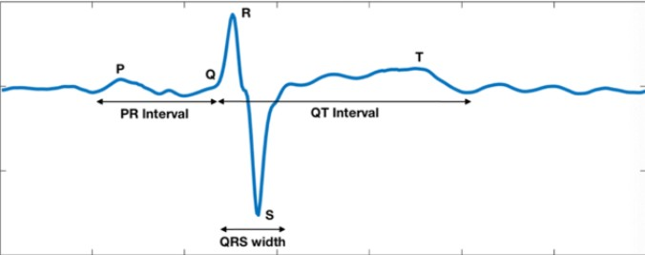
Introduction
●
Foetal Electrocardiogram is very important to monitor foetus health.
●
Requires robust extraction techniques.
Major challenge is separation of maternal and foetal ECG.
By using advanced digital signal processing techniques, we can extract out fECG.
Then after extraction, we can perform morphological analysis.
●
●
●

Slide 6
Literature Survey
●
Use bulleted points in the given font style only.

Slide 7
Gap/Issue Addressed
The loopholes of early techniques are -
Foetal Heart Rate(fHR) technique based on intermittent heart sound but lacked monitoring.
No technique to filter out noise from foetal heart sound.
Non invasive methods required.
Issues addressed in this paper.
Paper contains literature on latest and most advanced methodologies for filtering out fECG from maternal ECG and noise for morphological analysis.

Slide 8
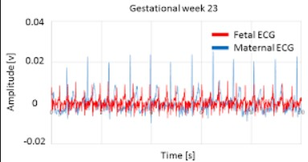
Problem Statement
Developing a robust method for
effective extraction of foetal Electrocardiograph. This involves –
Developing a non invasive technique,
Effective separation of fECG from maternal ECG and noise,
Continuous monitoring,
Making outcome ready for morphological analysis.

Slide 9
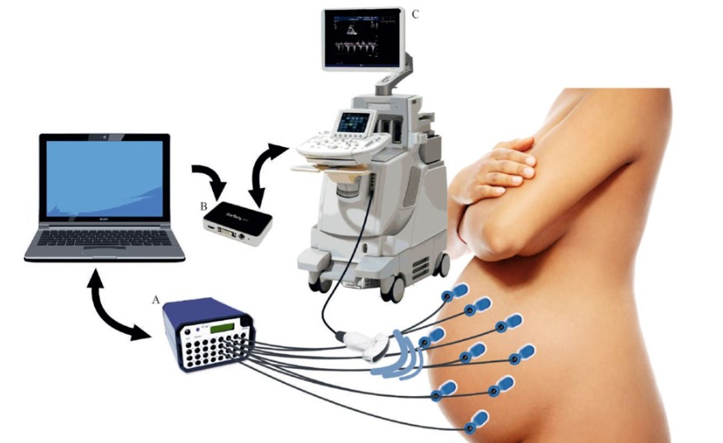
Methods
1. Recording protocol : In this part the recording protocol and different aspects of the dataset are described.

Slide 10
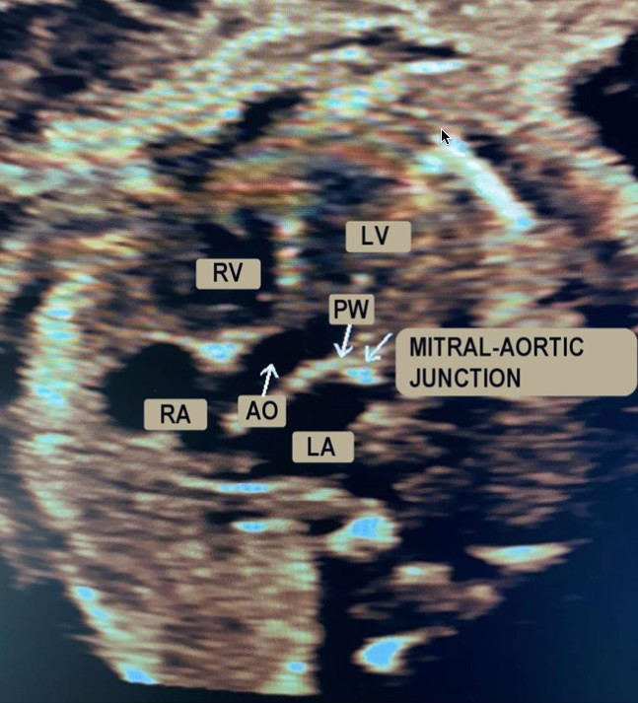
Methods
Pulsed-wave Doppler :
PWD signal acquisition:
For the recording of the PWD signal, five-chamber apical window is used.
PWD processing.
The whole video was converted into a single wide image using a MATLAB

Slide 11
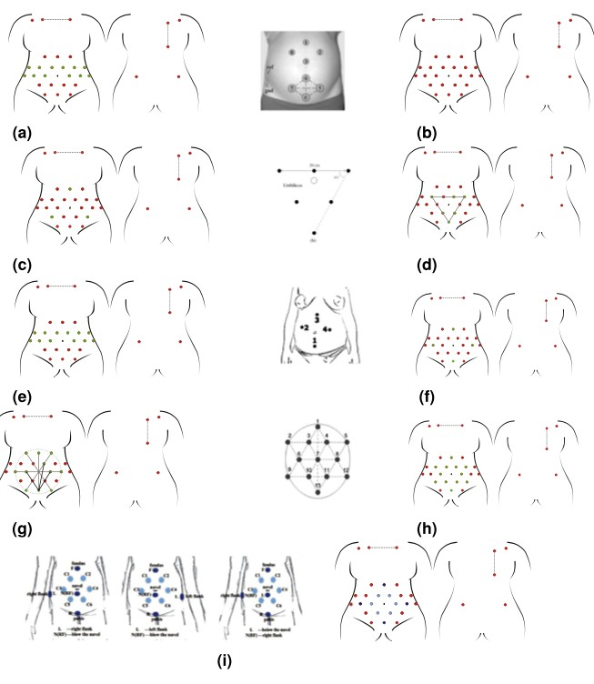
Methods
Multimodal synchronisation:
Offline synchronisation is performed on the signals recorded by exploiting an external trigger signal.
This offline synchronisation method was studied with the technicians of the iE33 device.

Slide 12
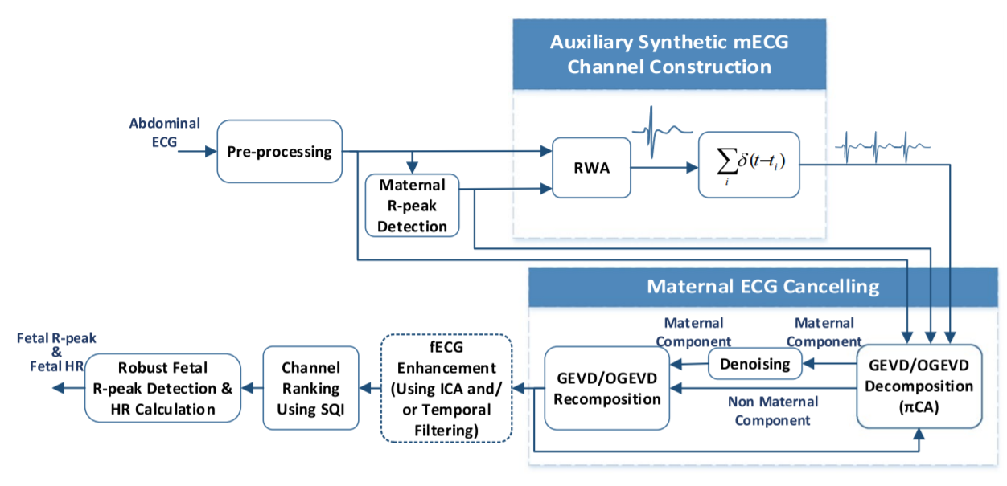
Technical Validation
Foetal ECG extraction

Slide 13
The overall foetal ECG and heart rate extraction scheme:
The maternal R-peaks are then detected from one of the reference thoracic channels. These peaks are used in a so-called deflation algorithm based on periodic component analysis to remove maternal ECG components.
The pre-processing stage consists of low-frequency baseline wander removal, high-frequency noise reduction, and power-line notch filtering.
The resulting foetal R-peaks were eventually used for extracting the average fECG morphology.
Depending on the signal quality, the fetal ECG might be directly detectable from one or more of the residual channels; or one might require an additional stage for extracting the fetal ECG from the background noise.

Slide 14
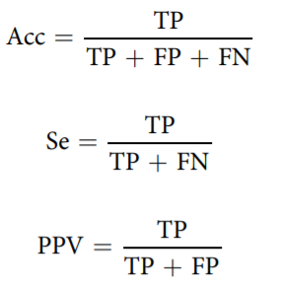
Technical Validation
2) Dataset quality assessment
The quantitative parameters considered for this assessment were: Accuracy (Acc), Sensitivity (Se), and Positive predictive value (PPV), computed as:
The detected fECG R-peaks are compared with the V-peaks in the PWD, accuracy does not account for the true negatives and is identical with the critical success index in the context of machine learning.
The fECG and acceptable QRS detection were extractable from 95.5% of the data segments, using the semi-supervised procedure.

Slide 15
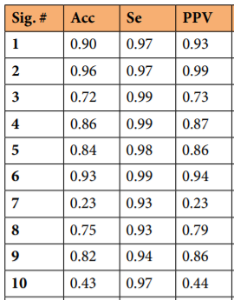
Result
The quantitative parameters considered for this assessment were: Accuracy (Acc), Sensitivity (Se), and Positive predictive value (PPV).
The median Acc, Se and PPV values were 0.79, 0.97 and 0.81, respectively.
Then, instantaneous fHR from the fECG and PWD were evaluated and compared.
The comparison was mainly qualitative and affected by both the different time resolutions of the two signals and limited accuracy in identifying fiducial points on the PWD signals.
The average value for each trace was derived from the instantaneous values.

Slide 16
Conclusion

Slide 17
References
Karplus, Kevin, and Alex Strong. “Digital Synthesis of Plucked-String and Drum Timbres.” Computer Music Journal, V: 7, I: 2, PP: 43-55, 1983.
Jacobson BH, Johnson A, Grywalski C, “The Voice Handicap Index (VHI): Development and Validation”, American Journal of Speech-Language Pathology, V: 6, PP: 66–70, 1997.
Mitra, Sanjit K., Gordana Jovanovic-Dolecek, and Mikhail K. Tchobanou. "On the Design of One-Dimensional Sparse Arrays with Apodized End Elements." IEEE Conference on Signal Processing, PP: 2239-2242, 2004

